Slide 1
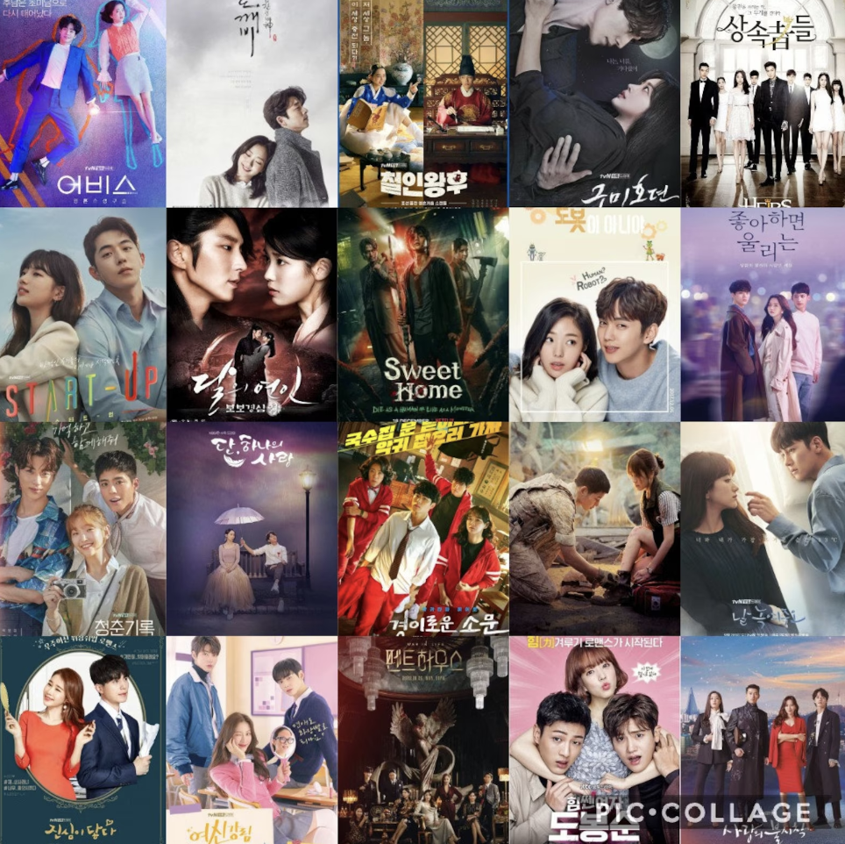
Korean Drama Recommendation System
DATA606- Capstone Project in Data Science
Under the guidance of Professor Dr. Chaojie(Jay) Wang
By: Sunjung Kim
KA62774

Slide 2
Background
Korean TV dramas, commonly referred to as K-dramas, have enjoyed widespread popularity across Asia since the 1990s. It's only in the past decade that this genre has made significant inroads into the entertainment markets of Europe and the Americas, subsequently garnering a substantial following among Western audiences and establishing itself as a global entertainment trend.
The use of recommender systems is prevalent in the digital marketplace, particularly in the realms of online streaming and shopping. These systems are adept at predicting products, movies, or shows that a consumer is likely to purchase or enjoy. Major companies like Netflix and Amazon employ these systems to enhance user experience by guiding them to content that aligns with their interests and viewing history.
In response to the increasing global interest in K-dramas, this recommender system is specifically designed to suggest Korean dramas. The recommendations are based on an analysis of the dramas that users have previously viewed by synopsis, providing a tailored and relevant selection of K-dramas that align with their viewing preferences.

Slide 3
Introduction
Analyzing patterns of similarity in K-dramas can provide a list of K-drama recommendations.
Recommendation systems involve predicting user preferences for unseen items.

Slide 4
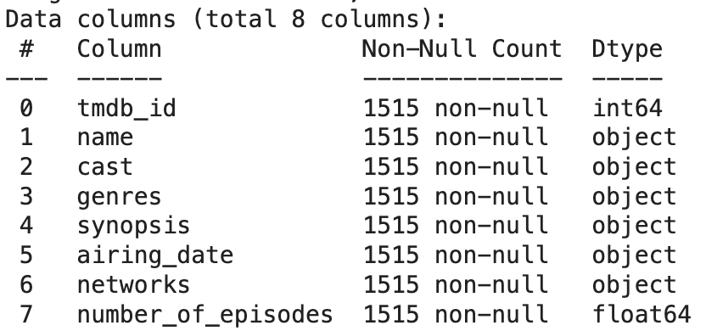
Data and Dataset
Data dictionary:
Data sources: TMDB website
Data size: 94.8 KB
Data shape (# of rows and # columns): 1515,8
Time Period: 1983-2023
Which variable/column will be your target/label in your ML model?
Target Column = tmbd_id
Which variables/columns may be selected as features/predictors for your ML models?
Feature columns = 'name', 'cast', 'genres’, 'synopsis'

Slide 5
Research Questions:
What are the most popular genres in South Korean dramas?
What are the most well-known Network company in South Korea?
Can I get a recommendation list based on the content?
What are the most common keywords associated with successful K-dramas?

Slide 6
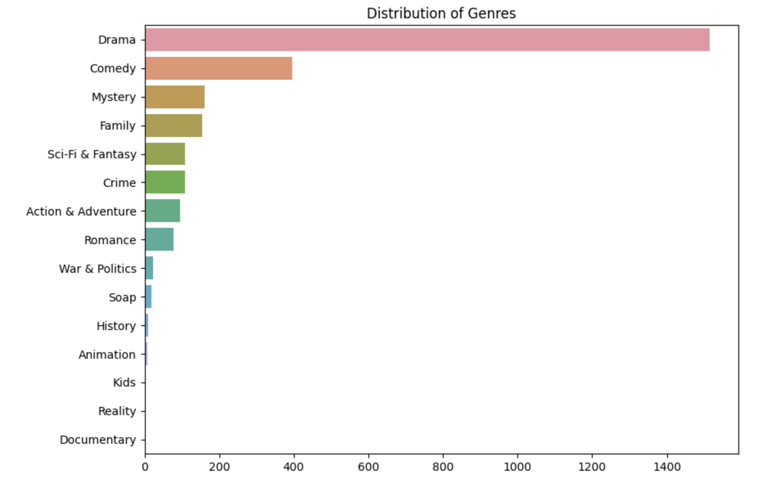
EDA

Slide 7
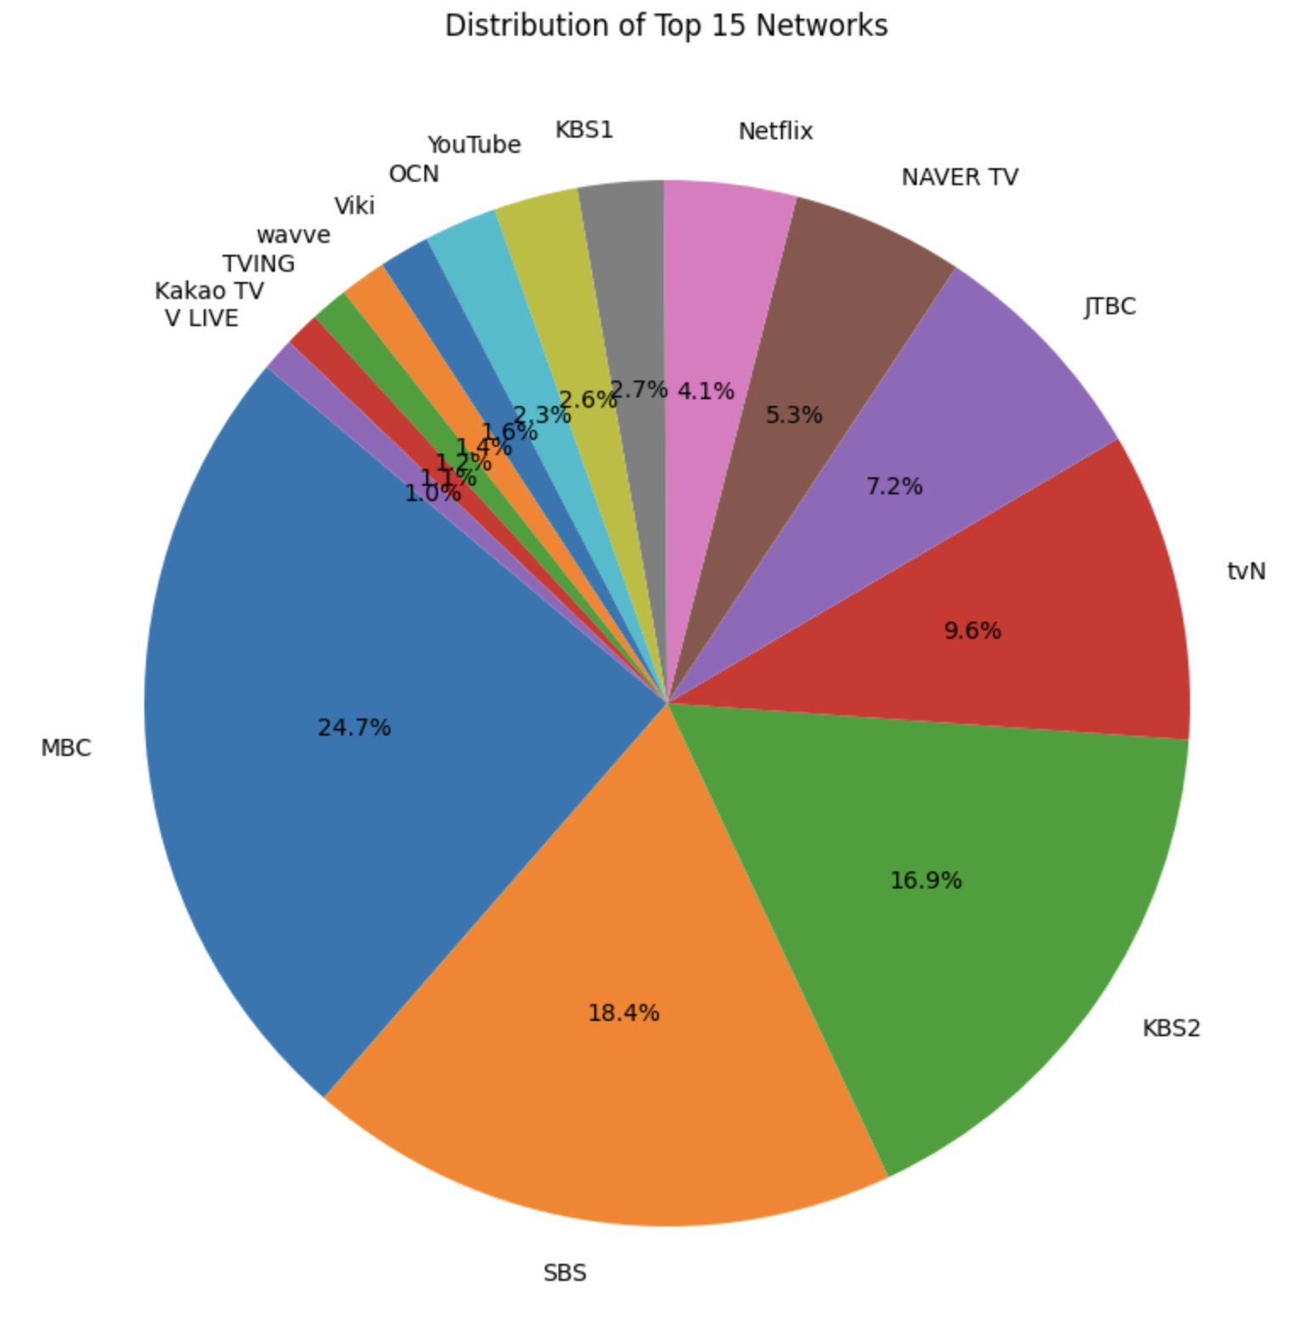
Results

Slide 8
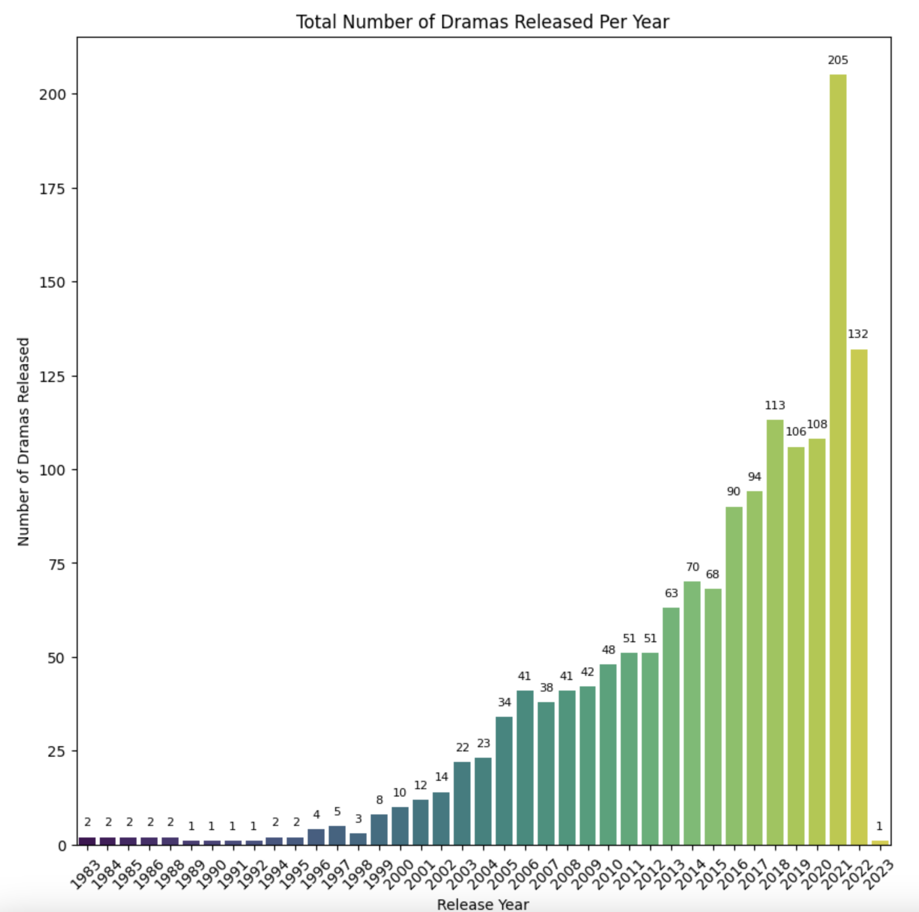
Results:

Slide 9
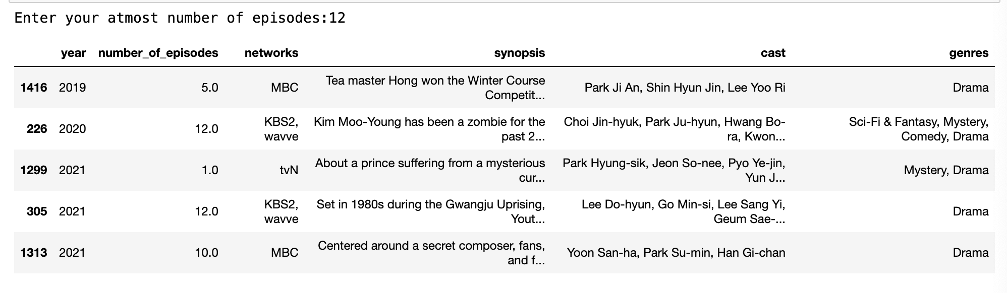
Results(Contd.)

Slide 10
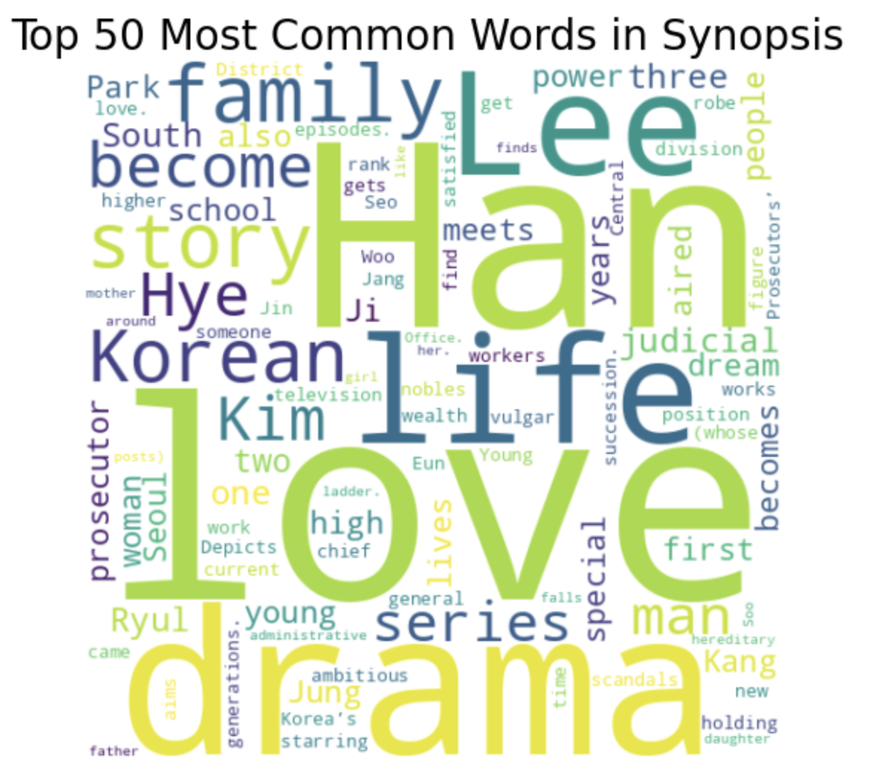
Results(Contd.)

Slide 11
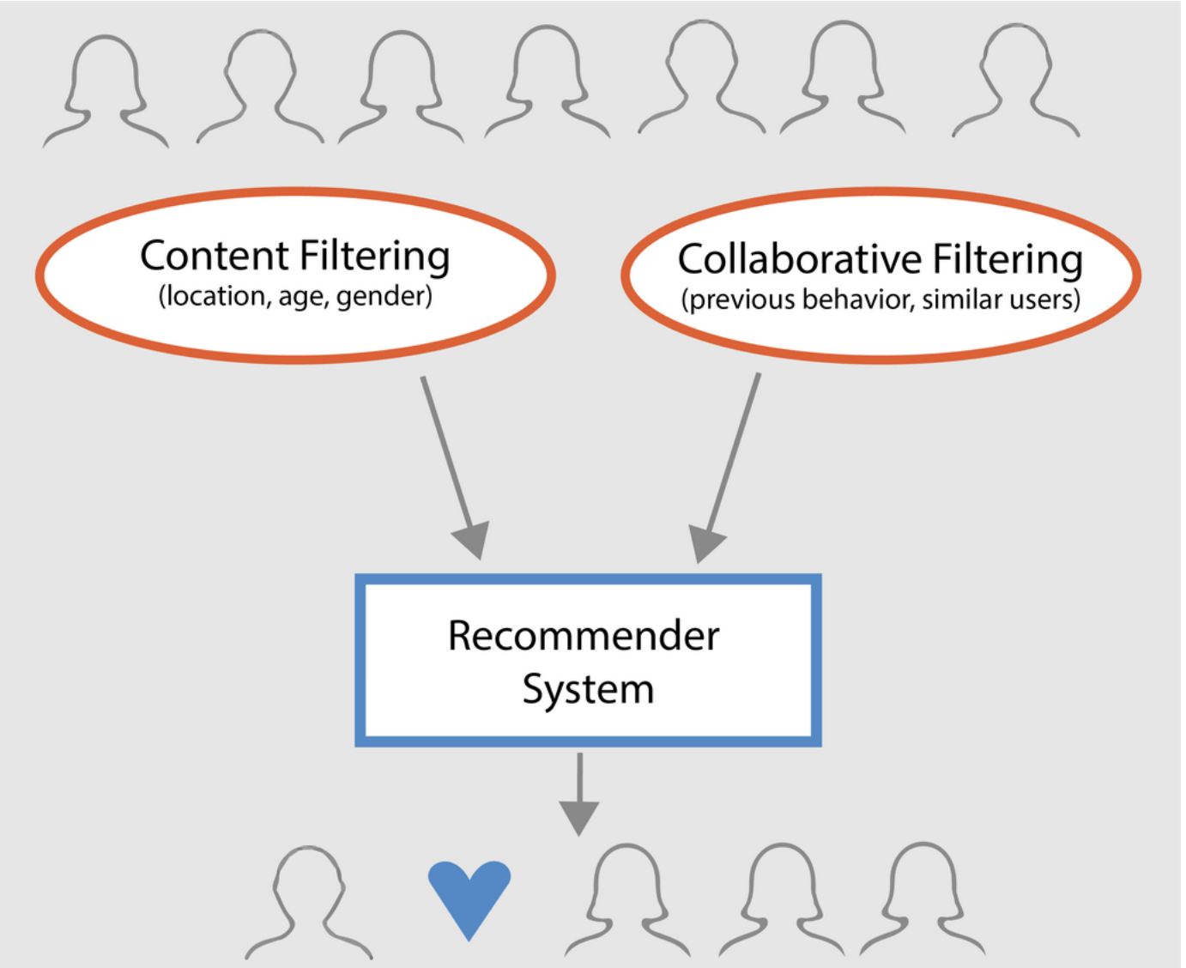
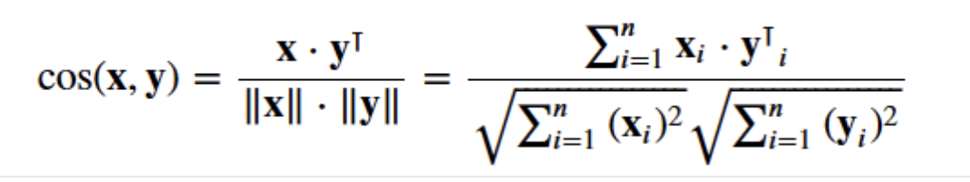
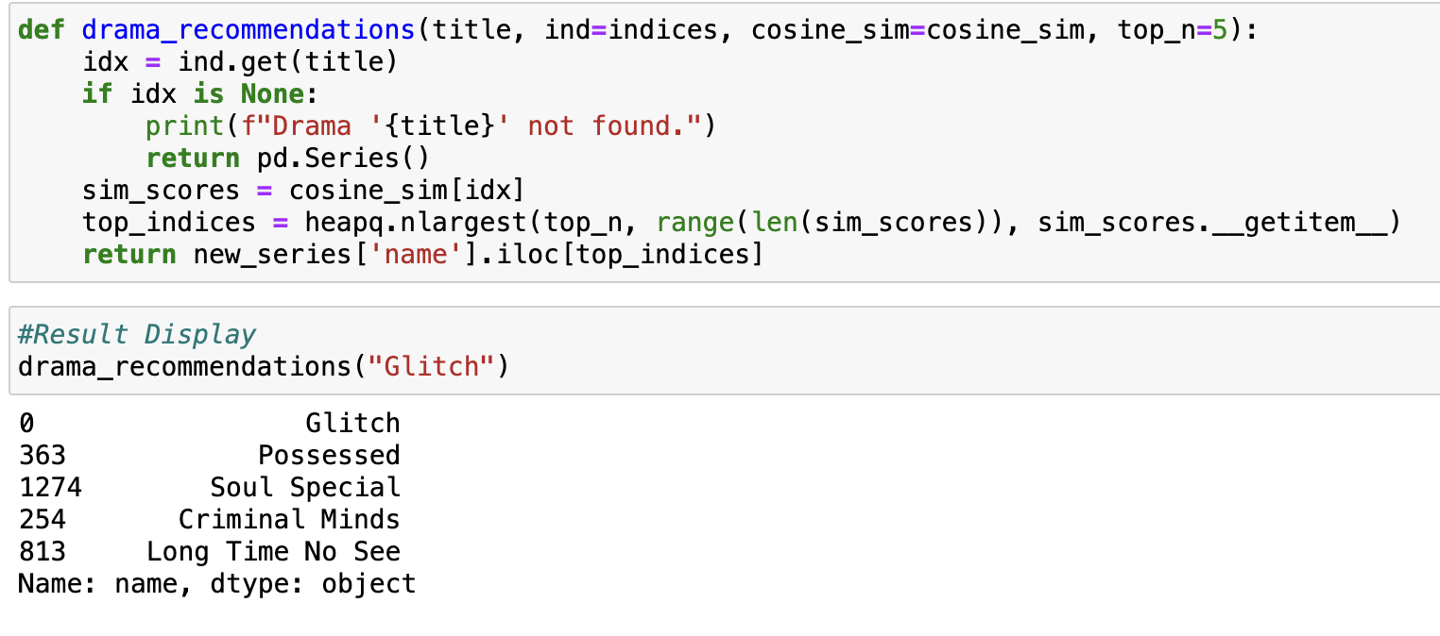
Content-Based Recommendation

Slide 12
Attributes Recommendation
The aim is to refine the system's ability to provide accurate recommendations by capturing nuanced aspects of the content. To achieve this, the recommender system will be developed with a focus on several key metadata elements. These include:
The top actors featured in the K-Drama.
The synopsis of K-Drama
The genres associated with the K-Drama.
By integrating these the recommender system is expected to deliver more precise and relevant suggestions, aligning closely with the individual preferences and interests of the users.

Slide 13
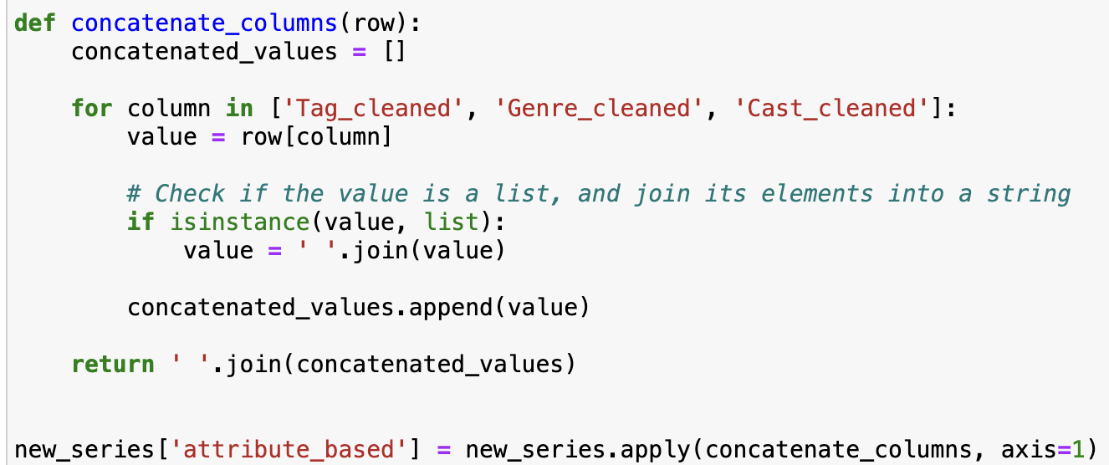
Attributes Recommendation(Con’t)
the concatenated column attribute_based in text form so here we convert it to numerical vectors for recommendation with CountVectorizer.
Calculation of Cosine Similarity of count_matrix_attribute.

Slide 14
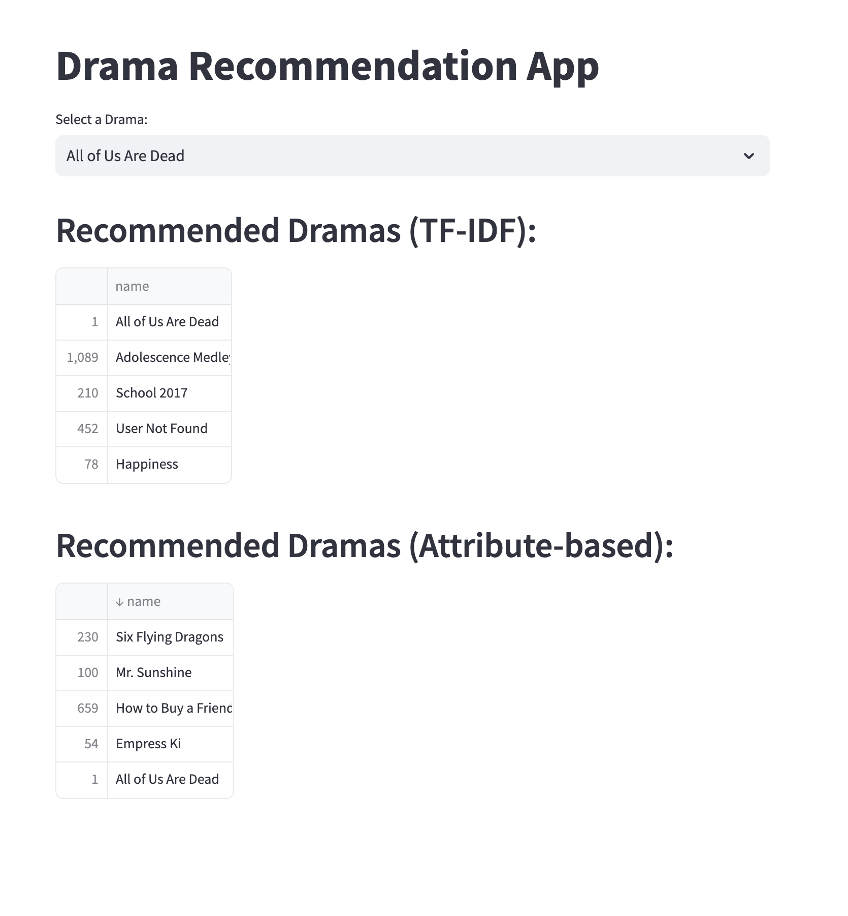
Web Application-Streamlit

Slide 15
Challenges
Data Quality and Availability: Address challenges related to sourcing and maintaining a high-quality, diverse dataset of Korean dramas, including issues with incomplete or biased data.
Algorithm Complexity: Discuss the complexities in developing and tuning recommendation algorithms, especially in catering to diverse user preferences.

Slide 16
Conclusion:
Implementing Cosine Similarity in a K-drama recommendation system can significantly enhance user satisfaction by providing personalized and relevant content suggestions. This approach is not only efficient in handling diverse data but also scales well with expanding K-drama libraries, making it an ideal choice for streaming platforms looking to improve their recommendation algorithms.

Slide 17
THANK YOU!

